Slide 1
Midwifery A cost-effective solution for US Maternity Care

Slide 2
Objectives
1. Provide an overview of current state of maternity care in the US
2. Review current maternity care payment models
3. Identify excellent outcomes and cost-effectiveness of midwifery
4. Discuss tangible opportunities for improved US maternity care
This presentation will:

Slide 3
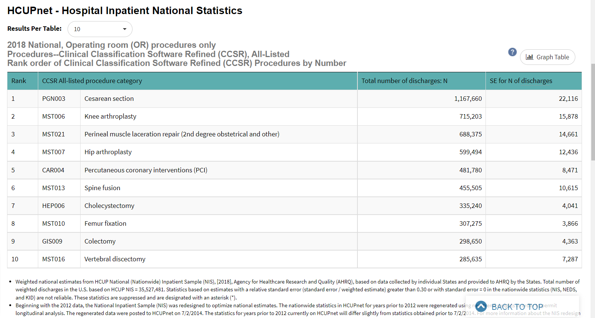
state of Maternity Care in the US
#1 reason for hospitalization in the US is childbirth (ahrq.gov, 2022)
#1 inpatient surgery in the US is C Section (1,167,660 C Sections in 2018) (ahrq.gov, 2022)
#1 most common Hospital Discharge in US is for Childbirth (3,612,999 hospital discharges in 2018)
Source: hcupnet.ahrq.gov (2022)
Notes:
HCUPnet. (2018). HCUPnet, Healthcare Cost and Utilization Project. Agency for Healthcare Research and Quality, Rockville, MD. https://hcupnet.ahrq.gov/
Martin, J. (2019). National Vital Statistics Reports Volume 68, Number 13, November 30, 2019, Births: Final Data for 2018. 47.

Slide 4
State of Maternity Care in the US Supply & Demand
Vast majority of pregnant women in US, pregnancy follows a routine physiological course and are considered “low-risk” or “moderate-risk” pregnancies
6-8% of pregnancies in the US are “high-risk”
Current makeup of US Maternity care providers:
- OB/GYN’s attend 90% of hospital births in US in 2020
- Midwives attend about 10% of hospital births in US
Projected shortage of up to 22,000 OB/GYN’s by 2050
OB/GYNs are surgical specialists trained to care for high-risk pregnancies
Midwives are licensed specialists trained to care for low & moderate risk pregnancies
Bottom Line = Mismatched maternity care workforce in US
90% of essential needs in maternal, newborn, and reproductive health could be addressed by midwives
Sources: UCSF High-risk Pregnancy; ACNM, 2022; Rosenberg, 2019; UNFPA, WHO, ICM, 2021
Notes:
Martin, J. (2019). National Vital Statistics Reports Volume 68, Number 13, November 30, 2019, Births: Final Data for 2018. 47.
Rosenberg, J. (2019, September 21). Physician Shortage Likely to Impact OB/GYN Workforce in Coming Years. AJMC. https://www.ajmc.com/view/physician-shortage-likely-to-impact-obgyn-workforce-in-coming-years
American College of Nurse-Midwives. (2022). ACNM - Professional Resources. https://www.midwife.org/Professional-Resources
https://www.ucsfhealth.org/conditions/high-risk-pregnancy

Slide 5
Current state of Maternity Care in the US
Sources: UCSF High-risk Pregnancy; ACNM, 2022; Rosenberg, 2019; UNFPA, WHO, ICM, 2021
10%
US births
in hospitals
by Midwives
90% US births attended by OB-GYNs
(surgeons trained to treat high-risk patients)
Mismatched workforce to meet US childbirth demands
6-8%
of US
pregnancies
(high-risk)
Vast majority of pregnancies in US
(low-risk to moderate-risk)
Notes:
Martin, J. (2019). National Vital Statistics Reports Volume 68, Number 13, November 30, 2019, Births: Final Data for 2018. 47.
Rosenberg, J. (2019, September 21). Physician Shortage Likely to Impact OB/GYN Workforce in Coming Years. AJMC. https://www.ajmc.com/view/physician-shortage-likely-to-impact-obgyn-workforce-in-coming-years
American College of Nurse-Midwives. (2022). ACNM - Professional Resources. https://www.midwife.org/Professional-Resources
https://www.ucsfhealth.org/conditions/high-risk-pregnancy

Slide 6
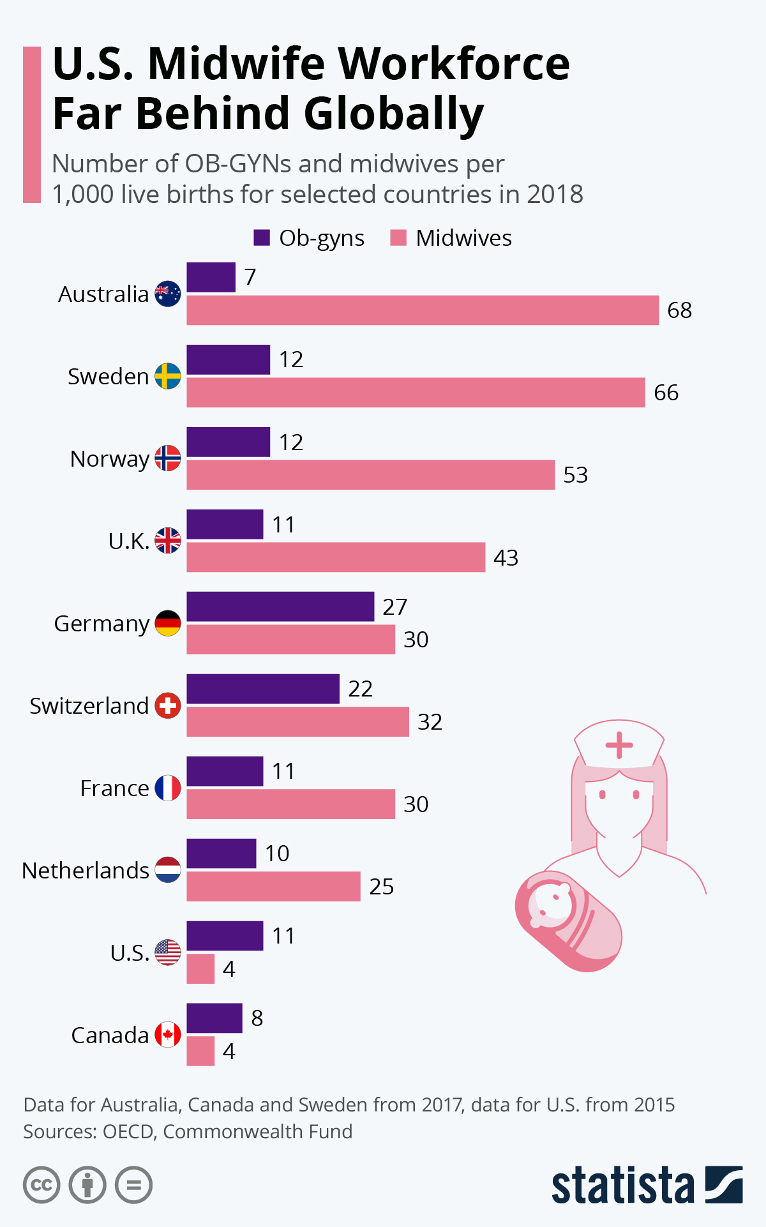
US Maternity care compared to other developed countries in 2018
Sources: Roper, 2020; Tikkanen et al, 2020;
OECD Health Data 2020
Notes:
Roper, W. (2020). Infographic: U.S. Midwife Workforce Far Behind Globally. Statista Infographics.
https://www.statista.com/chart/23559/midwives-per-capita/
The Commonwealth Fund. (2020, November 18). Maternal Mortality and Maternity Care in the United States Compared to 10 Other Developed Countries. https://doi.org/10.26099/411v-9255
OECD. (2020). Health—OECD Data. TheOECD. http://data.oecd.org/health.htm
OECD Health Data 2020, showing data for 2018 except 2017 for Switzerland and the UK; 2016 for New Zealand; 2012 for France (Chart)

Slide 7
Current Maternity Care outcomes in the US
Primary low-risk C section rates – 26.3% in 2021 in the US
The US maternal mortality rate for 2021 was 32.9 deaths/100,000 live births, up from 23.8 deaths/100,000 live births in 2020, compared with a rate of 20.1 in 2019, and 17.4 in 2018.
Recent CDC report – 80% Maternal deaths are preventable
Preterm birth rates – 10% of newborns born prematurely in 2020
US Women are more-likely to die from pregnancy-related reasons as compared to all other high-income developed countries
C section rates went from 5.5% in 1970 to 32.1% of all US births in 2021
CDC, 2022
4 of 5 Pregnancy related deaths are preventable
Sources: Hoyert, 2023, 2022, 2021, 2020; Chinn, 2020; Mann et al, 2018; Osterman et al, 2023
Notes:
https://www.cdc.gov/media/releases/2022/p0919-pregnancy-related-deaths.html
Hoyert. (2022, February 22). Maternal Mortality Rates in the United States, 2020. https://www.cdc.gov/nchs/data/hestat/maternal-mortality/2020/maternal-mortality-rates-2020.htm
Maternal-Health-Blueprint.pdf (whitehouse.gov)

Slide 8
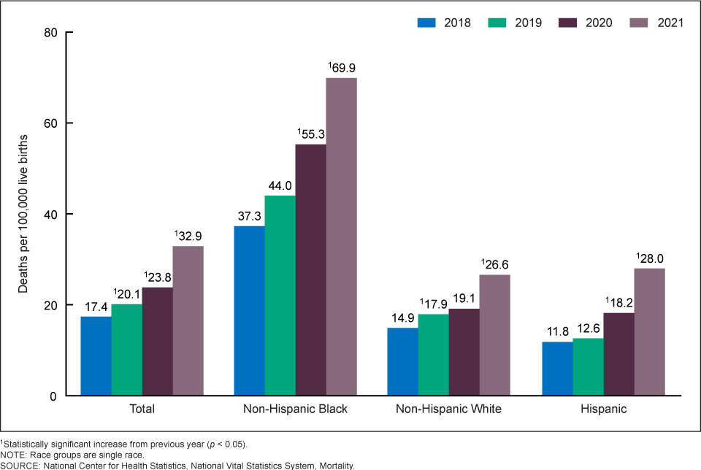
Disparities in Maternal Mortality in the US
In 2021, the maternal mortality rate for non-Hispanic Black women was 2.6 times the rate for non-Hispanic White women (Hoyert, 2023)
Worsening maternal mortality rates in US (Hoyert, 2023)
Source: Hoyert et al, 2023
Notes:
https://www.cdc.gov/media/releases/2022/p0919-pregnancy-related-deaths.html
Hoyert. (2022, February 22). Maternal Mortality Rates in the United States, 2020. https://www.cdc.gov/nchs/data/hestat/maternal-mortality/2020/maternal-mortality-rates-2020.htm
(Peterson et al., 2019)

Slide 9
CONTINUUM OF MATERNITY CARE IN THE US
During Pregnancy
Day of Delivery
1-6 days Postpartum
7-42 days Postpartum
43-365 days Postpartum
53% deaths occurred 7-365 days postpartum
Source: Trost et al, 2022
Notes:
Trost SL, Beauregard J, Njie F, et al. Pregnancy-Related Deaths: Data from Maternal Mortality Review Committees in 36 US States, 2017-2019. Atlanta, GA: Centers for Disease Control and Prevention, US Department of Health and Human Services; 2022.

Slide 10
Pregnancy related deaths in the us
CDC, 2022
4 of 5 Pregnancy related deaths are preventable
Source: Trost et al, 2022; Hoyert et al, 2022
Notes:
https://www.cdc.gov/media/releases/2022/p0919-pregnancy-related-deaths.html
Pregnancy-Related Deaths: Data from Maternal Mortality Review Committees in 36 US States, 2017–2019 | CDC

Slide 11
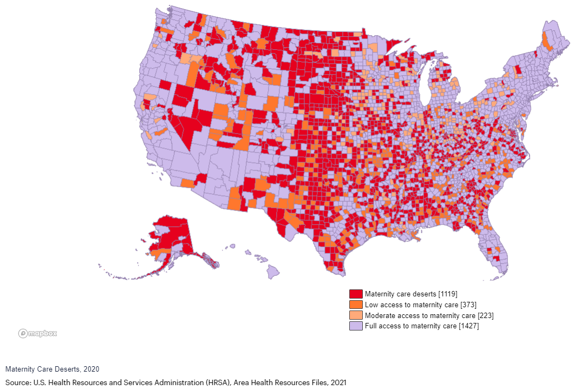
US Maternity Care Deserts (2020)
Maternity Care Deserts - 35% of counties in the US are “maternity care deserts” with neither a hospital maternity unit, nor any obstetrician-gynecologist or certified nurse midwife
Women are about 60% more likely to die from pregnancy related causes in US Maternity Care Deserts
Maternal mortality ranges from 10.1 deaths/100,000 births in California to 43.5 deaths/100,000 births in Arkansas
Sources: Brigance et al, 2022; Wallace et al, 2021; March of Dimes, 2022; CDC MMWR 2018-2021
Notes:
March of Dimes. (2022). Maternity Care Deserts Report [Page]. https://www.marchofdimes.org/maternity-care-deserts-report
Maternal-Health-Blueprint.pdf (whitehouse.gov)

Slide 12
“Our vision for the future is that the United States will be considered the best country in the world to have a baby.” -Biden-Harris Administration, 2022
Notes:
Maternal-Health-Blueprint.pdf (whitehouse.gov)

Slide 13
payment models for maternity care in us
Maternity Care – global routine care for pregnant patients, which includes prenatal, birth, and postpartum care (through 42 days postpartum)
Providers are typically reimbursed a bundled payment for the total provider services from the initial diagnosis of the pregnancy until the end of the postpartum period
Medicaid covers 41% of births in US
Private insurance covers 51.7% of births in US
Remaining 7-8% of US births covered by TRICARE, Indian Health Services, charity, self-pay, or uninsured
Medicaid bundled reimbursement amounts are less than private insurance bundle reimbursement amounts, for both vaginal births and c sections
In many states, bundled reimbursement payments are less than prenatal care costs alone
Bottom line = hospitals frequently lose $ on maternity care, especially from Medicaid-insured patients
Sources: Martin et al, 2022; Osterman et al, 2023; Baker et al, 2021; Truven Health Analytics, 2013; Ins for Medicaid Innovation, 2020; Johnson et al, 2020
Notes:
Blue Cross Blue Shield, Florida (2022)
Truven Health Analytics, 2013.
8% Other includes TRICARE births, non-US citizen births etc.

Slide 14
payment models for us maternity care
About 4 in 5 of all dollars paid on behalf of maternal and newborn care go to the facility and other payments for the relatively brief hospital phase of care
Just 1 in 5 of all $ paid for Maternity Care goes to prenatal and postnatal care
Reimbursement from private insurance companies & Medicaid does not cover the costs for postpartum care after 42 days
Yet, 53% of pregnancy-related deaths in the US occur from 7days – 1 year postpartum.
Hospital maternity care units are closing, due to losing $ on maternity care
CONTINUUM OF MATERNITY CARE IN THE US
During Pregnancy
Day of Delivery
1-6 days Postpartum
7-42 days Postpartum
43-365 days Postpartum
4 of 5 of all $ paid for Maternity care
53% deaths occurred 7-365 days postpartum
Sources: Baker et al, 2021; Truven Health Analytics, 2013; Ins for Medicaid Innovation, 2020; Johnson et al, 2020
Notes:
Blue Cross Blue Shield, Florida (2022)
Truven Health Analytics, 2013.
ACOG – Collaborative model

Slide 15
midwifery
Overview of midwifery
Benefits/Outcomes of midwifery
Cost-effectiveness of midwifery

Slide 16
Midwifery practice in the us
CNMs are licensed, independent health care providers with prescriptive authority in all 50 states, the District of Columbia
CNMs are registered nurses who obtain additional graduate education to become CNMs. CMs also have graduate degrees
In addition to birthing care, services provided by CNMs/CMs include annual exams, writing prescriptions, basic nutrition counseling, parenting education, patient education, and reproductive health visits
CNMs are APRNs who are specialized in physiologic birth, trained to provide care for low-risk and moderate-risk pregnancies
The American College of Nurse-Midwives (ACNM) is the professional association representing certified nurse- midwives (CNMs) and certified midwives (CMs) in the United States
CNMs and CMs are defined as primary care providers under federal law
Sources: ACNM, 2022; ACNM Core Data Survey 2019
Notes:
American College of Nurse-Midwives. (2022). ACNM - Professional Resources. https://www.midwife.org/Professional-Resources
American College of Nurse-Midwives. ACNM Core Data Survey 2019. American College of Nurse-Midwives website. Accessed April 20, 2022.

Slide 17
Benefits of midwifery
2016 Cochrane review compared midwifery-led care to other models of care for childbearing women and their infants
Midwife-led care associated with less regional analgesia, less preterm births, and more likely for spontaneous vaginal birth (less c sections)
There was also a trend towards cost-saving as compared to other models of care
Women who had midwife-led care reported higher rates of maternal satisfaction
Midwifery-led care shows evidence of strengthening health systems, including building their workforce, makes the difference in reversing maternal morbidity & mortality
Since 1990, the 21 countries most successful in reducing maternal mortality rates—by at least 2.5% a year—have done this by deploying midwives (Lancet series, 2014)
Sources: Sandall et al, 2016; Attanasio et al 2020; ICM/UNFPA/WHO 2021; Renfrew et al, 2014; Souter et al, 2019
Notes:
Sandall, J., Soltani, H., Gates, S., Shennan, A., & Devane, D. (2016). Midwife‐led continuity models versus other models of care for childbearing women. Cochrane Database of Systematic Reviews, 2016(4). https://doi.org/10.1002/14651858.cd004667.pub5
Renfrew MJ, McFadden A, Bastos MH, et al. Midwifery and quality care: fi ndings from a new evidence-informed framework for maternal and newborn care. Lancet 2014; published online June 23. http://dx.doi.org/10.1016/S0140-6736(14)60789-3.

Slide 18
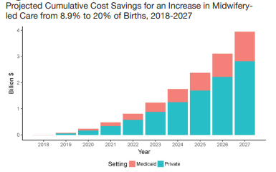
Cost-effectiveness of midwifery
Less $ to train and deploy Midwives into workforce
Less expenses during intrapartum care (less medical and surgical interventions)
2019 Policy Brief estimated costs and clinical outcomes associated with midwife-led versus OB-led Maternity care
If midwifery-led care increased from 9% to 20% in US, it would result in $4 billion in cost savings by year 2027
Sources: Kozhimannil, 2019 (Table used with permission)
Notes:
Centers for Disease Control and Prevention. (2022, September 19). CDC Newsroom. CDC. https://www.cdc.gov/media/releases/2022/p0919-pregnancy-related-deaths.html
Kozhimannil, K. B. (2019). MORE MIDWIFE-LED CARE COULD GENERATE COST SAVINGS AND HEALTH IMPROVEMENTS. 4. https://www.sph.umn.edu/sph-2018/wp-content/uploads/docs/policy-brief-midwife-led-care-nov-2019.pdf

Slide 19
need for improvement
Childbirth is the most common reason for hospitalization in the US
Maternal morbidity & mortality is worsening in the US, with wide disparities across the United States
Bottom line = Urgent need to improve quality and value of US Maternity care
C sections are increasing, and are the #1 surgery in hospitalized patients in the US
Reimbursement for maternity care does not fully cover the costs incurred throughout the continuum of maternity care
Hospital maternity care units are closing, due to losing $ on maternity care
Maternity care deserts (35% of all US counties) – limited access to high-demand maternity care in the US
Current state of US Maternity care – not meeting the needs of pregnant women in the US, with worsening outcomes
Workforce improvements
Payment improvements
Tangible Opportunities for Improved US Maternity Care

Slide 20
Tangible opportunities for improvement – payment improvements
Need for adequate reimbursement for maternity care services that continues through 1 year postpartum
Current maternity care reimbursement model (fee-for-service model) – hospitals in the US lose money & consequently close maternity care units
Unintended repercussions of bundled payment models for maternity care have led to limited access to maternity care
Adequate reimbursement models for both Medicaid and private insurance payers (the 2 main payers of maternity care in US)
Missing periods of greatest risk during maternity care cycle
Evidence shows the midwifery is cost-effective, affordable, and sustainable (similar return on investment of cost per death averted by vaccines) - Lancet series, 2014
Current payment models – fragmented with focus on pathology, postpartum care is sporadic especially for women with limited resources and gaps in insurance coverage
Sources: Truven Health Analytics, 2013; ACOG 2014; Renfrew et al, 2014; Yu & Feldman, 2021
Notes:
Truven Health Analytics, 2013.
ACOG – Collaborative model
https://whyy.org/segments/how-philadelphia-escaped-disaster-in-the-face-of-a-dozen-shuttered-maternity-wards/
Renfrew MJ, McFadden A, Bastos MH, et al. Midwifery and quality care: fi ndings from a new evidence-informed framework for maternal and newborn care. Lancet 2014; published online June 23. http://dx.doi.org/10.1016/S0140-6736(14)60789-3.

Slide 21
Tangible opportunities for improvement – payment innovations
Value-based payment – an alternative payment model with linkage to quality, value, and health equity
Payment changes, like value-based payment, would pay for value/quality of care & reduce health disparities
Social determinants of health impact patients’ health outcomes
Value-based payment models would integrate maternity care with social services at the local, state, and federal levels
Fee-for-service payment models are outdated, inefficient, and accelerate disparities in maternal care
Value-based payment models – may reduce the frequency of unnecessary interventions and decrease costs of maternity care
Increased midwife utilization in value-based models would lead to high-quality and affordable prenatal, labor, and postpartum care
Sources: Werner et al, 2021; Agarwal et al, 2020; Murray Horwitz, 2018
Notes:
Truven Health Analytics, 2013.
ACOG – Collaborative model
https://whyy.org/segments/how-philadelphia-escaped-disaster-in-the-face-of-a-dozen-shuttered-maternity-wards/
Renfrew MJ, McFadden A, Bastos MH, et al. Midwifery and quality care: fi ndings from a new evidence-informed framework for maternal and newborn care. Lancet 2014; published online June 23. http://dx.doi.org/10.1016/S0140-6736(14)60789-3.

Slide 22
Tangible opportunities for improvement – Workforce improvements
HRSA’s Nurse Corps program, which provides loan repayment and scholarships for nurse-midwives practicing in rural and underserved communities
Close the gaps in US maternal health care - build a workforce prepared to meet needs of US women from antepartum-postpartum
Midwives = prepared to meet the needs in US Maternity care
Diversifying the Maternity workforce, support community-based programs, integrating hospital & community settings
AIM (Alliance for Innovation on Maternal Health) – collaboration led by ACOG and 30 organizations, which have created bundles of best practices for maternity care & 3 most common preventable causes of pregnancy-related death
Implementation of AIM bundles in all states / birthing centers– goal to reduce maternal morbidity and mortality through improvement strategies
Sources: AIM (saferbirth.org); hrsa.gov; Mann et al, 2018; Murray Horwitz et al, 2018
Notes:
https://www.whitehouse.gov/wp-content/uploads/2022/06/Maternal-Health-Blueprint.pdf
https://saferbirth.org/ (Alliance for Innovation on Maternal Health)

Slide 23
Maternity Care in the US – the bottom line
Improve maternal morbidity and mortality – provide integrated care throughout the whole continuum of maternity care
Need for more Midwives in US Maternity Care Workforce
Payment Model improvement for Maternity Care

Slide 24
Midwives are the essential link to improving Maternity Care in America
(Lancet series, 2014)

Slide 25
References
Agarwal, R., Liao, J. M., Gupta, A., & Navathe, A. S. (2020). The Impact Of Bundled Payment On Health Care Spending, Utilization, And Quality: A Systematic Review. Health Affairs (Project Hope), 39(1), 50–57. https://doi.org/10.1377/hlthaff.2019.00784
Alliance for Innovation on Maternal Health (AIM). (n.d.). Retrieved October 27, 2022, from https://www.acog.org/en/practice-management/patient-safety-and-quality/partnerships/alliance-for-innovation-on-maternal-health-aim
American College of Nurse-Midwives. (2022). ACNM - Professional Resources. https://www.midwife.org/Professional-Resources
Baker, M. V., Butler-Tobah, Y. S., Famuyide, A. O., & Theiler, R. N. (2021). Medicaid Cost and Reimbursement for Low-Risk Prenatal Care in the United States. Journal of Midwifery & Women’s Health, 66(5), 589–596. https://doi.org/10.1111/jmwh.13271
Centers for Disease Control and Prevention. (2022, September 19). CDC Newsroom. CDC. https://www.cdc.gov/media/releases/2022/p0919-pregnancy-related-deaths.html
Chinn, J. J., Eisenberg, E., Artis Dickerson, S., King, R. B., Chakhtoura, N., Lim, I. A. L., Grantz, K. L., Lamar, C., & Bianchi, D. W. (2020). Maternal mortality in the United States: Research gaps, opportunities, and priorities. American Journal of Obstetrics and Gynecology, 223(4), 486-492.e6. https://doi.org/10.1016/j.ajog.2020.07.021
HCUPnet. (2018). HCUPnet, Healthcare Cost and Utilization Project. Agency for Healthcare Research and Quality, Rockville, MD. https://hcupnet.ahrq.gov/.
High-Risk Pregnancy. (n.d.). Ucsfhealth.Org. Retrieved December 15, 2022, from https://www.ucsfhealth.org/Conditions/High Risk Pregnancy
Hoyert, D. (2022, February 22). Maternal Mortality Rates in the United States, 2020. https://www.cdc.gov/nchs/data/hestat/maternal-mortality/2020/maternal-mortality-rates-2020.htm
International Federation of Health Plans. (2019). International comparisons of health care prices from the 2017 iFHP survey. HCCI. https://healthcostinstitute.org/hcci-research/international-comparisons-of-health-care-prices-2017-ifhp-survey
Kozhimannil, K. B. (2019). MORE MIDWIFE-LED CARE COULD GENERATE COST SAVINGS AND HEALTH IMPROVEMENTS. 4.
March of Dimes. (2022). Maternity Care Deserts Report [Page]. https://www.marchofdimes.org/maternity-care-deserts-report
Mann, S., Hollier, L., McKay, K., & Brown, H. (2018). What We Can Do about Maternal Mortality—And How to Do It Quickly. The New England Journal of Medicine, 379(18), 1689.
Martin, J. (2019). National Vital Statistics Reports Volume 68, Number 13, November 30, 2019, Births: Final Data for 2018. 47.
Martin, J., Hamilton, B., & Osterman, M. (2022). Births in the United States, 2021. National Center for Health Statistics (U.S.). https://doi.org/10.15620/cdc:119632

Slide 26
References
Murray Horwitz, M. E., Molina, R. L., & Snowden, J. M. (2018). Postpartum Care in the United States—New Policies for a New Paradigm. New England Journal of Medicine, 379(18), 1691–1693. https://doi.org/10.1056/NEJMp1806516
Maternal-Health-Blueprint.pdf. (n.d.). Retrieved October 27, 2022, from https://www.whitehouse.gov/wp-content/uploads/2022/06/Maternal-Health-Blueprint.pdf
National Health Equity Strategy. (n.d.). Retrieved October 27, 2022, from https://www.bcbs.com/the-health-of-america/healthequity/strategy/
OECD. (2020). Health—OECD Data. TheOECD. http://data.oecd.org/health.htm
Petersen, E. E. (2019). Racial/Ethnic Disparities in Pregnancy-Related Deaths—United States, 2007–2016. MMWR. Morbidity and Mortality Weekly Report, 68. https://doi.org/10.15585/mmwr.mm6835a3
Rajbanshi, S., Norhayati, M. N., & Nik Hazlina, N. H. (2020). High-risk pregnancies and their association with severe maternal morbidity in Nepal: A prospective cohort study. PLoS ONE, 15(12), e0244072. https://doi.org/10.1371/journal.pone.0244072
Renfrew, M. J., McFadden, A., Bastos, M. H., Campbell, J., Channon, A. A., Cheung, N. F., Silva, D. R. A. D., Downe, S., Kennedy, H. P., Malata, A., McCormick, F., Wick, L., & Declercq, E. (2014). Midwifery and quality care: Findings from a new evidence-informed framework for maternal and newborn care. The Lancet, 384(9948), 1129–1145. https://doi.org/10.1016/S0140-6736(14)60789-3
Roper, W. (2020). Infographic: U.S. Midwife Workforce Far Behind Globally. Statista Infographics. https://www.statista.com/chart/23559/midwives-per-capita/
Rosenberg, J. (2019, September 21). Physician Shortage Likely to Impact OB/GYN Workforce in Coming Years. AJMC. https://www.ajmc.com/view/physician-shortage-likely-to-impact-obgyn-workforce-in-coming-years
Sandall, J., Soltani, H., Gates, S., Shennan, A., & Devane, D. (2016). Midwife‐led continuity models versus other models of care for childbearing women. Cochrane Database of Systematic Reviews, 2016(4). https://doi.org/10.1002/14651858.cd004667.pub5
Sweeping Changes Needed to Meet White House Maternal Mortality Reduction Goals. (2022, October 19). Penn LDI. https://ldi.upenn.edu/our-work/research-updates/sweeping-changes-needed-to-meet-white-house-maternal-mortality-reduction-goals/
ten Hoope-Bender, P., de Bernis, L., Campbell, J., Downe, S., Fauveau, V., Fogstad, H., Homer, C. S. E., Kennedy, H. P., Matthews, Z., McFadden, A., Renfrew, M. J., & Van Lerberghe, W. (2014). Improvement of maternal and newborn health through midwifery. The Lancet, 384(9949), 1226–1235. https://doi.org/10.1016/S0140-6736(14)60930-2
The Commonwealth Fund. (2020, November 18). Maternal Mortality and Maternity Care in the United States Compared to 10 Other Developed Countries. https://doi.org/10.26099/411v-9255
The-cost-of-having-a-baby-in-the-us.pdf. (n.d.). Retrieved November 17, 2022, from https://www.nationalpartnership.org/our-work/resources/health-care/maternity/archive/the-cost-of-having-a-baby-in-the-us.pdf
Trost, S., Beauregard, J., Chandra, G., Njie, F., Berry, J., Harvey, A., & Goodman, D. A. (2022). Pregnancy-Related Deaths: Data from Maternal Mortality Review Committees in 36 US States, 2017-2019. 6.
Yu, A., & Feldman, N. (2021). How Philadelphia escaped disaster in the face of a dozen shuttered maternity wards. WHYY. https://whyy.org/segments/how-philadelphia-escaped-disaster-in-the-face-of-a-dozen-shuttered-maternity-wards/

Slide 27
References
ACOG. (2014). Safe Prevention of the Primary Cesarean Delivery. https://www.acog.org/en/clinical/clinical-guidance/obstetric-care-consensus/articles/2014/03/safe-prevention-of-the-primary-cesarean-delivery
Attanasio, L. B. (n.d.). Midwife-led care and obstetrician-led care for low-risk pregnancies: A cost comparison. Birth, 47(1), 57.
Brigance, C., Lucas, Jones, Davis, Oinuma, Mishkin, & Henderson. (2022). Nowhere to Go: Maternity Care Deserts Across the U.S. [Page]. https://www.marchofdimes.org/maternity-care-deserts-report
High-Risk Pregnancy. (n.d.). Ucsfhealth.Org. Retrieved December 15, 2022, from https://www.ucsfhealth.org/Conditions/High Risk Pregnancy
Hoyert. (2023, March 16). Maternal Mortality Rates in the United States, 2021. https://www.cdc.gov/nchs/data/hestat/maternal-mortality/2021/maternal-mortality-rates-2021.htm
Johnson, W., Milewski, A., Martin, K., & Clayton, E. (2020). Understanding Variation in Spending on Childbirth Among the Commercially Insured. 11.
Osterman, Hamilton, Martin, J., Driscoll, A. K., & Valenzuela. (2023). National Vital Statistics Reports Volume 72, Number 1 January 31, 2023.
Souter, V., Nethery, E., Kopas, M. L., Wurz, H., Sitcov, K., & Caughey, A. B. (2019). Comparison of Midwifery and Obstetric Care in Low-Risk Hospital Births. Obstetrics and Gynecology, 134(5), 1056–1065. https://doi.org/10.1097/AOG.0000000000003521
Tikkanen, R. (2020). Maternal Mortality and Maternity Care in the United States Compared to 10 Other Developed Countries. https://doi.org/10.26099/411v-9255
UNFPA, WHO, ICM. (2021, May). The State of the World’s Midwifery 2021. United Nations Population Fund. https://www.unfpa.org/publications/sowmy-2021
Wallace, M., Dyer, L., Felker-Kantor, E., Benno, J., Vilda, D., Harville, E., & Theall, K. (2021). Maternity Care Deserts and Pregnancy-Associated Mortality in Louisiana. Women’s Health Issues: Official Publication of the Jacobs Institute of Women’s Health, 31(2), 122–129. https://doi.org/10.1016/j.whi.2020.09.004
Werner, R. M., Emanuel, E., Pham, H. H., & Navathe, A. S. (n.d.). The Future of Value-Based Payment: A Road Map to 2030. 24

